Slide 1
Culture and Power in Digitally Mediated Intercultural Rhetorical Encounters
Beau Pihlaja, PhD,
Assistant Professor
Technical Communication and Rhetoric
Email: beau.pihlaja@ttu.edu
Website: www.beaupihlaja.com
Twitter handle: @ProfBeau

Slide 2
Key research question
How do common communication technologies (email, phone, IM chat, etc.) define and transform intercultural rhetorical encounters?
Notes:
Decision to begin the point of inquiry, not at 30,000 feet, but at the site of concrete, material engagement across “cultures” (provisionally defined) within very specific, concrete activities.

Slide 3
Theoretical frame
Activity Theory (AT) coordinated with Actor-Network Theory (ANT) as both analytical frameworks and tools for studying and engaging the digitally mediated intercultural rhetorical encounter

Slide 4
AT and intercultural encounters
Subject “culture A”
Subject “culture B”
Tools/Mediating Artifacts
Tools/Mediating Artifacts
Subject
Object/Objective
Object/Objective
Subject
Rules/Norms
Community
Division of Labor
Division of Labor
Community
Rules/Norms
Notes:
Takes as axiomatic Leontiev’s assertion that there is no such thing as “objectless” activity. Seeks to afford that same object-orientation we understand for ourselves to intercultural others, believing they are operating in socio-cultural environments at least as complex as our own, while providing concrete points of focus for articulating that complexity.

Slide 5
Coordinating AT and ANT
Tools
Subject
Object/Objective
Rules
Community
Div. of Labor
vs.
Actor
Notes:
My suggestion is, once you’ve conducted an AT analysis. You look at the same “area” in your organization/process through an ANT lens, following one person/thing through the process. This will draw attention to things you might have missed when viewing it through the AT lens.

Slide 6
Note on “coordinating” AT/ANT
Attempts to use both seem to call for supplementation:
Spinuzzi (2008)
AT ANT
McNair & Paretti (2010)
AT+ “Politics of the Artifact” + Speech Act Theory
Sun (2012)
AT + British Cultural Studies (articulation, assemblage [Latour, 2005]) + Genre Theory
Rose & Walton (2015)
Ethical import of “sociocultural” lens to “posthuman” analysis
[Note: Discussing methodological implications for “decolonial” projects at CCCC, Friday, March 16th, 2:00-3:15, Room: Mary Lou [ML] Williams B]

Slide 7
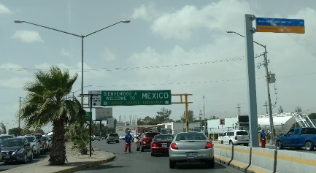
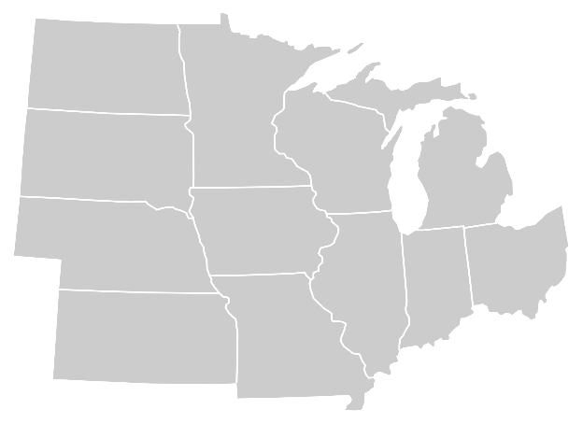
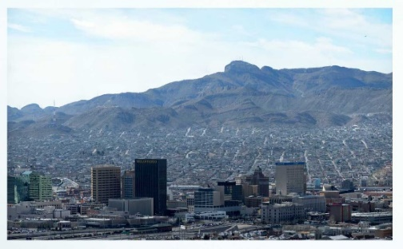
Research site
Email
Phone Calls
WhatsApp/WhatsApp Groups
Google Drive cloud documents
Juárez, MX
Productos de la Frontera, SA
(Image by Shereth distributed under a CC-BY 2.0 license)
(Photograph by Hadley Paul Garland distributed under a CC-BY 2.0 license)
Midwest Products
Home Product Corp.
Border Products
El Paso, TX
Notes:
Small manufacturing company producing home products and furniture components for individuals and corporate customers in the United States.
Main administrative office (A) in El Paso, TX.
Border Products
The company has a factory (F) just across the border in Juárez, Mexico. (maquila model factory)
Productos de la Frontera, SA
The company’s major customers (C) have sales offices in the Midwest of the United States with individual customers locally and all over the world.
Home Product Corp (central Midwest US)
Midwest Products (upper Midwest US)

Slide 8
Research process
Mapping site(s) as Activity System
Tools
Comm. Techs:
WhatsApp, WhatsApp Groups
Gmail (web-based)
Google Drive
Excel (Production Schedule)
Objects/Objective
Subjects
Product Sets 1, 2, 3
Site A Staff
Site F Staff
On time shipping/delivery
Site C Staff
Site S Staff
On time deposit/payment
Maintain Cash Flow
Rules/Norms
Communities
Division of Labor
Formal
NAFTA Regulations
Mx. Tax Regulations
Mx. Labor Law
US Labor Law
Informal
Whatsapp capabilities
Site A Staff
Site F Staff
Cities
El Paso—Juárez
Professional
Worker-Mexico
Worker-El Paso
Formal-Informal
Inventory Reconciling Practices
Negotiation on Payment/Delivery Dates
Organizational
Site A, Site F, Site C
Site C Staff
Site S Staff
Family
Multicultural entities
Entities at border

Slide 9
Key identifications
Digitally mediated rhetorical work
Cultural difference
Digitally mediated intercultural rhetorical encounters

Slide 10
Arturo
Weekly standing meeting RE: cash flow
Esteban
Face-to-Face
Site F floor staff
RE: order priority
Carlos
Javier
Arturo
WhatsApp admin group
Esteban
WhatsApp exchange RE: order 3253
Roger
WhatsApp
Gerardo
Digital Mediation
Beatriz
Daily contact
Henry
Phone
Luis
Luis
Daily contact
RE: Orders
Henry
Email
Jorge
Javier
Ricardo
Beatriz
Luis
Email chain
RE: Order 3253
Henry
Luis
As needed/ongoing contact RE: Orders
Henry
Google Drive
M
B²
B¹
A
Cultural Difference

Slide 11
Intercultural digitally mediated encounters: Example exchange
Two moments of “silence” from Monday AM to Wednesday PM

Slide 12
“so that [Roger] can believe me. Because you know there’s always a trust issue. Because—‘Oh no, the order shipped’ and then…you know…a little bit of the Latin…sense of humor. No, not ‘sense of humor’ but way of doing business [laughs].”

Slide 13
Network Infrastructure
ATT Network
Smartphone
èWhatsApp
èChat
Affordance 2: possible not to do so
Immediacy: phone physically “on” person
Site to exercise power
Tools
Affordance 1: possible to respond immediately
Product
Esteban
Delivery of Product
Object/Objective
Roger
Payment
Delivery/ “properly interpreted payment”
Rules/Norms
Distribution of labor
Communities
Expectation of response time
“Latin way of doing business”
“Because…there’s always a trust issue. ‘Oh no, the order shipped’ and then—you know—a little bit of the Latin . . . sense of humor. No, not ‘sense of humor’ but way of doing business [laughs].”
Tolerance for silence
Expectations of Order Payment/Delivery

Slide 14
Relevant Findings
Object/ive(s) at the center of mapping shared intercultural activity.
Object/ive(s) organize the exercise of “power” in digitally mediated intercultural encounters.
“Silence” as material affordance of digital communication tool creates the space/possibility to “invent” the cultural other.

Slide 15
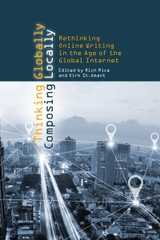
Q&A
Be sure to check out a new volume from Rick Rice and Kirk St. Amant: Thinking Globally Composing Locally: Rethinking Writing in the Age of the Global Internet.
Available from Utah State University Press
Including a chapter from Beau Pihlaja:
“Activity theory, actor-network theory, and culture in the 21st century”

Slide 16
Bibliography
McNair, L. D., & Paretti, M. C. (2010). Activity Theory, Speech Acts, and the ‘“Doctrine of Infelicity”’: Connecting Language and Technology in Globally Networked Learning Environments. Journal of Business and Technical Communication, 24(3), 323–357.
Rose, E. J., & Walton, R. (2015). Factors to actors: Implications of posthumanism for social justice work. In Proceedings of the 33rd Annual International Conference on the Design of Communication (p. 33:1–33:10). New York, NY, USA: ACM.
Spinuzzi, C. (2008). Network: Theorizing Knowledge Work in Telecommunications (1st ed.). Cambridge University Press.
Sun, H. (2012). Cross-Cultural Technology Design: Creating Culture-Sensitive Technology for Local Users. Oxford, New York: Oxford University Press.

